Slide 1
Final Report | Capstone Project – The Battle of Neighborhoods Finding a Better Place in Scarborough, Toronto

Slide 2
Introduction
The purpose of this project is to help people explore better facilities nearby. It will help people make wise and effective decisions to choose a good neighborhood among the many other communities in Scarborough, Toronto. Many people are migrating to various states in Canada. They need a lot of research to find good housing prices and reputable schools for their children. This project is suitable for those who are looking for a better community. Easy access to cafes, schools, supermarkets, medical stores, grocery stores, shopping centers, theaters, hospitals, like-minded people, etc. This project aims to create a characteristic analysis for people migrating to Scarborough to search for the best community as a cross-community comparative analysis. These characteristics include moderate house prices and better schools, based on grades, crime rates in the specific area, road connectivity, weather conditions, good emergency management, fresh water and wastewater, and water resources for the transport of feces. in sewers and recreational facilities. It will help people understand the region and community before moving to a new city, state, country or place to work or start a new life.
Foursquare API Data:
We need data from several locations in many areas of this autonomous region. Use the "Foursquare" location information to get this information. Foursquare is a location data provider that provides information about locations and events all the way in your area of interest. This information includes location names, locations, menus, and even photos. Therefore, Foursquare's location platform is used as the only data source, as all the required information provided can be obtained via the API. When it finds a list of nearby, it connects to the Foursquare API and collects information about places in all of its neighbors. Each neighborhood selected in a radius of 100 meters. Data obtained from Foursquare contained information about places at a specified distance from the longitude and latitude of the zip code. The information obtained for each location is as follows:
1. Neighborhood
2. Neighborhood Latitude
3. Neighborhood Longitude
4. Venue
5. Name of the venue e.g. the name of a store or restaurant
6. Venue Latitude
7. Venue Longitude
8. Venue Category

Slide 3
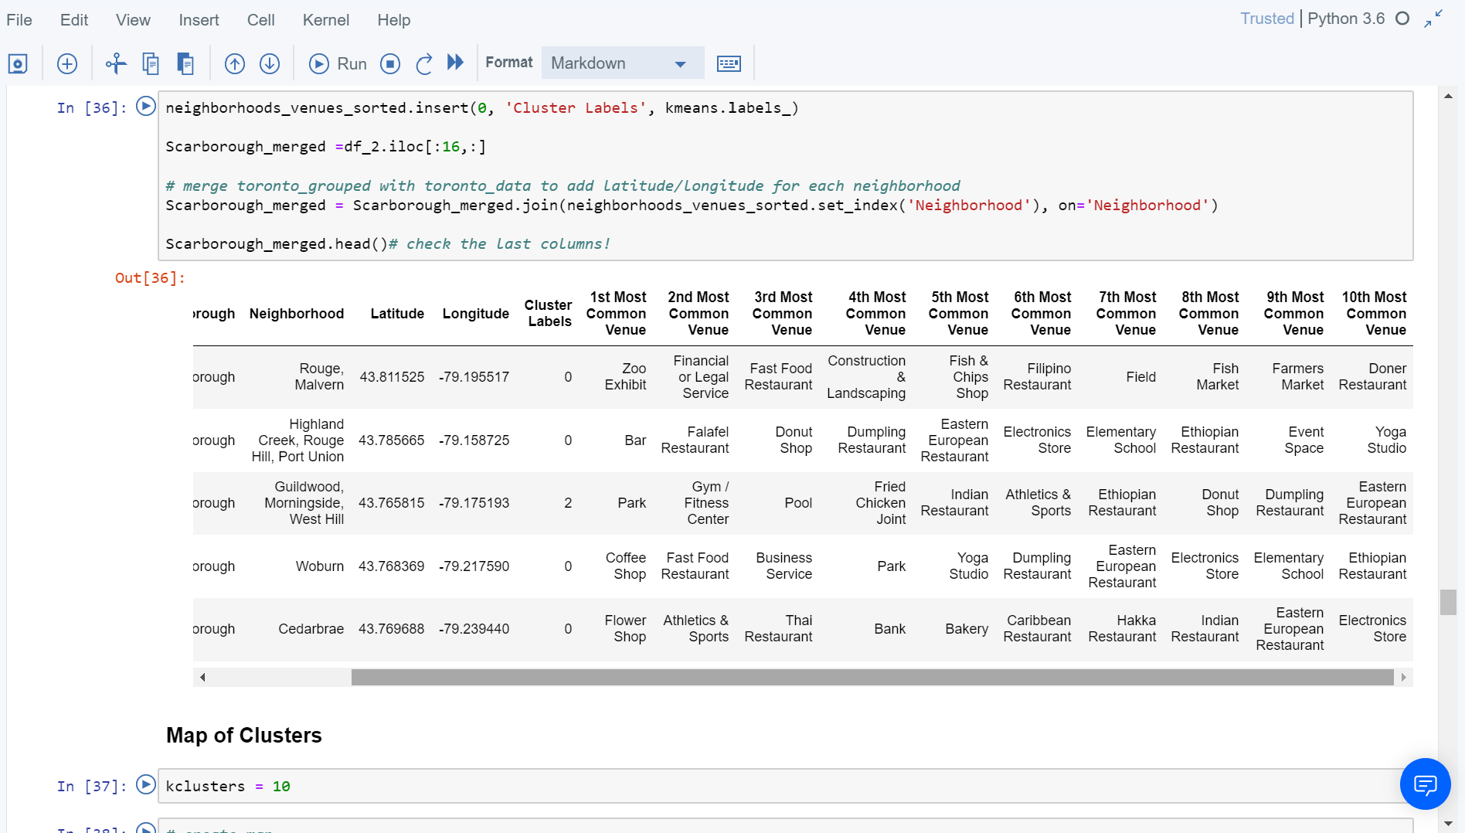
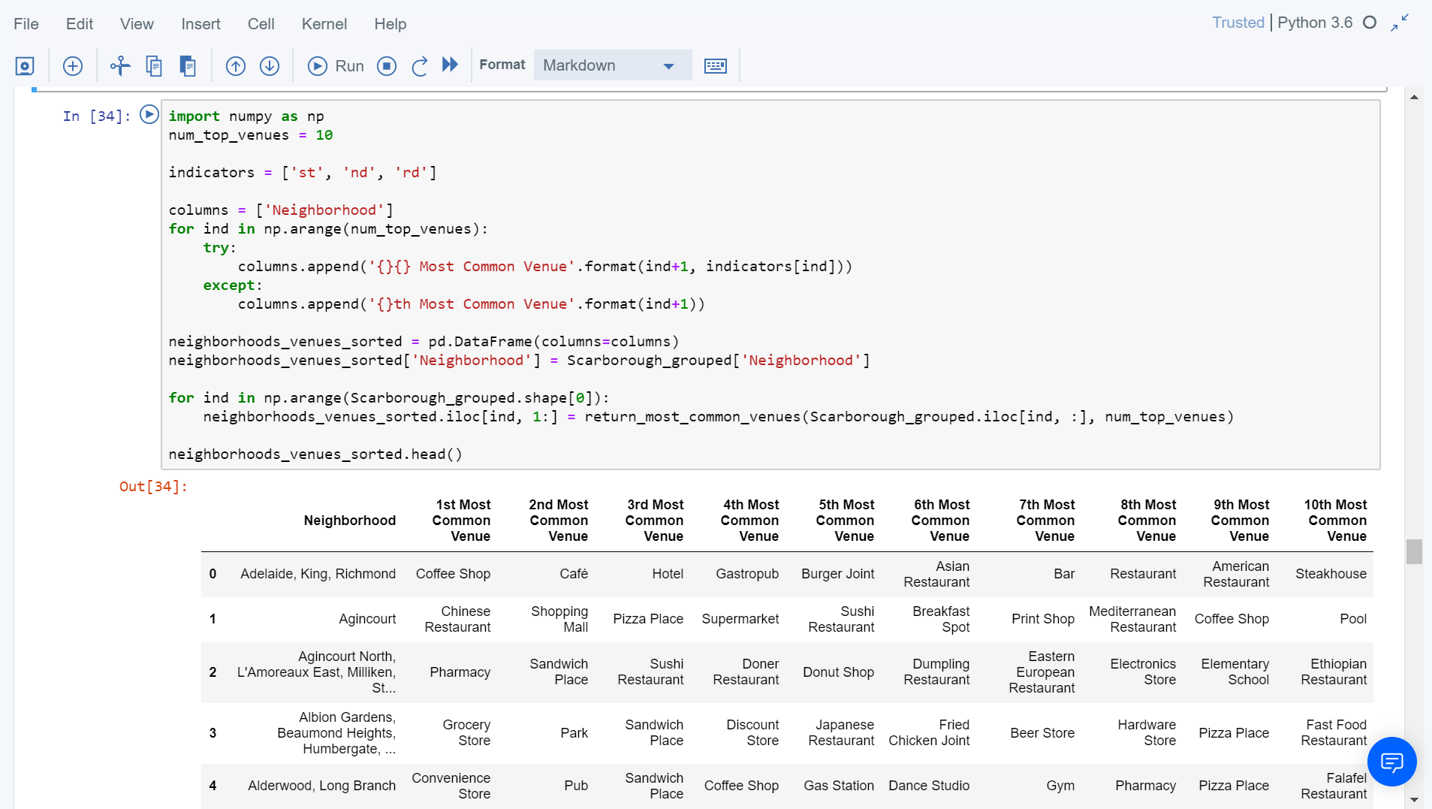
Methodology Section
Clustering Approach:
In order to compare the similarities between the two cities, we decided to explore the neighborhoods, subdivide them, and then group them to find similar neighborhoods in big cities like New York and Toronto. To do this, we need to group the data, which is a form of unsupervised machine learning: k stands for clustering algorithm.
Using K-Means Clustering Approach Most Common venues near Neighborhood

Slide 4
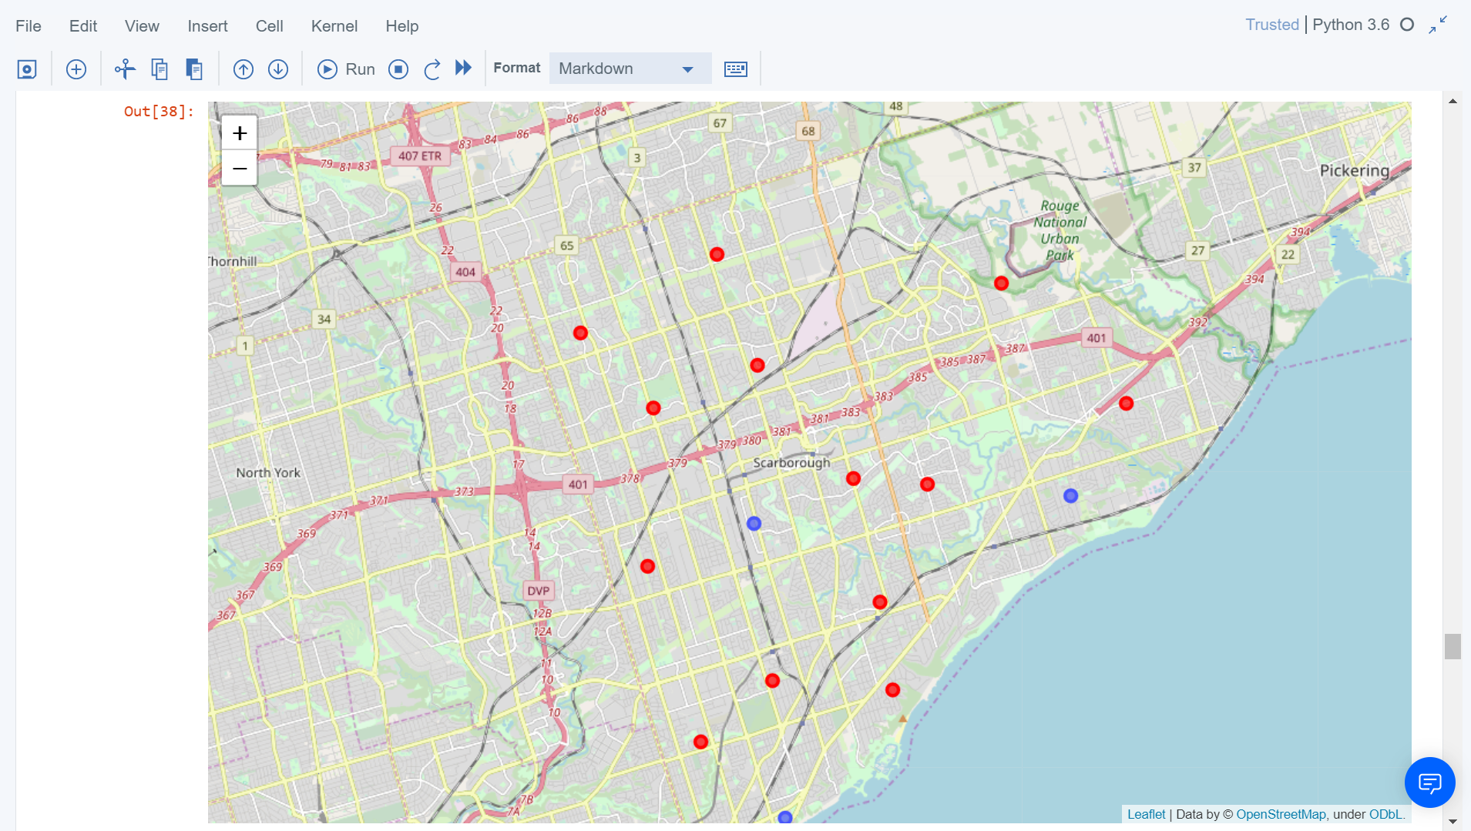
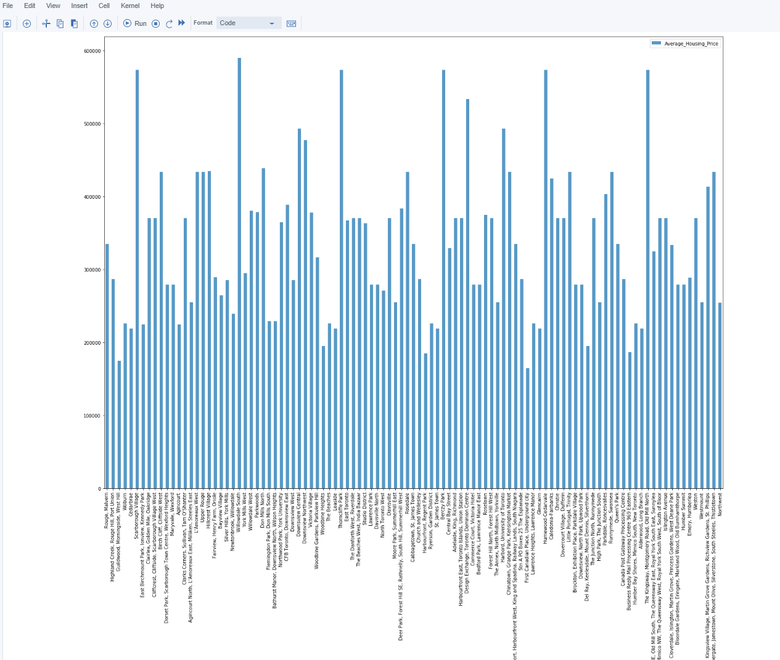
Results Section
Map of Clusters in Scarborough Average Housing Price by Clusters in Scarborough

Slide 5
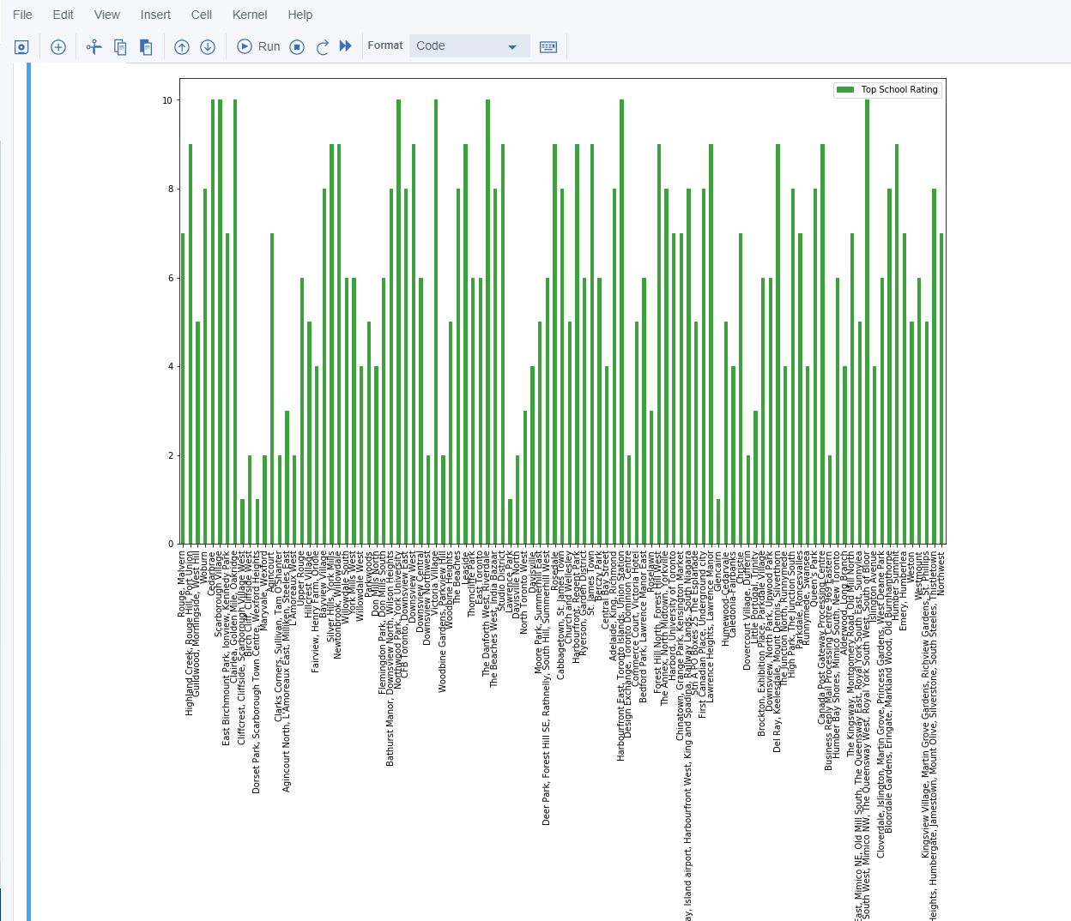
School Ratings by Clusters in Scarborough
The Location:
Scarborough is a popular destination for new Canadian immigrants. As a result, it has become one of the most diverse and multicultural areas of the Toronto metropolitan area, with various religious groups and places of worship. Immigrants have been a hot topic in the last few years, along with governments that need more restrictions for immigrants and refugees, but the general trend of immigrants in Canada is one of the increasing trends.
Foursquare API:
The project uses the Foursquare API as a primary data collection source, as the database of millions of locations has a location API that provides the ability to perform location search, location sharing and business details in particular. I used it.

Slide 6
Conclusion
In this project, using the kmeans clustering algorithm, I divided the neighborhood into 10 (ten) different groups and 103 different latitudes and longitudes from the data set, with very similar neighborhoods around it. Using the chart above, the results were displayed to specific communities based on average home prices and school ratings. I feel like my hard work has paid off and I think this course covering all topics is greatly appreciated. This project showed me a practical application that can use data science tools to solve real situations that affect people and finances. Using Folium for mapping is a very powerful technique that can integrate information and make analysis and decision making more reliable.
Future Works:
This project can go on to find the best home in Scarborough with greater precision. The best approach is based on all the necessary things (daily necessities or things we need to live a better life) and in terms of profitability.
Libraries Which are Used to Develope the Project:
Pandas: For creating and manipulating dataframes.
Folium: Python visualization library would be used to visualize the neighborhoods cluster distribution of using interactive leaflet map. Scikit Learn: For importing k-means clustering.
JSON: Library to handle JSON files.
XML: To separate data from presentation and XML stores data in plain text format.
Geocoder: To retrieve Location Data.
Beautiful Soup and Requests: To scrap and library to handle http requests.
Matplotlib: Python Plotting Module.

